Slide 1
19CSE303-Introduction to Embedded System

Slide 2
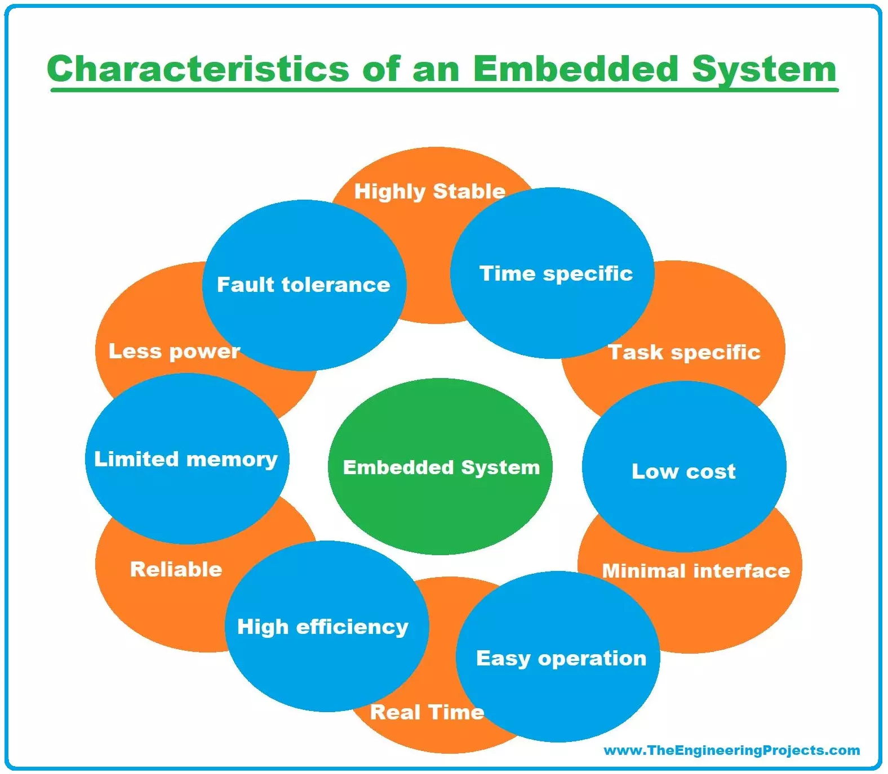
Characteristics of Embedded Systems

Slide 3
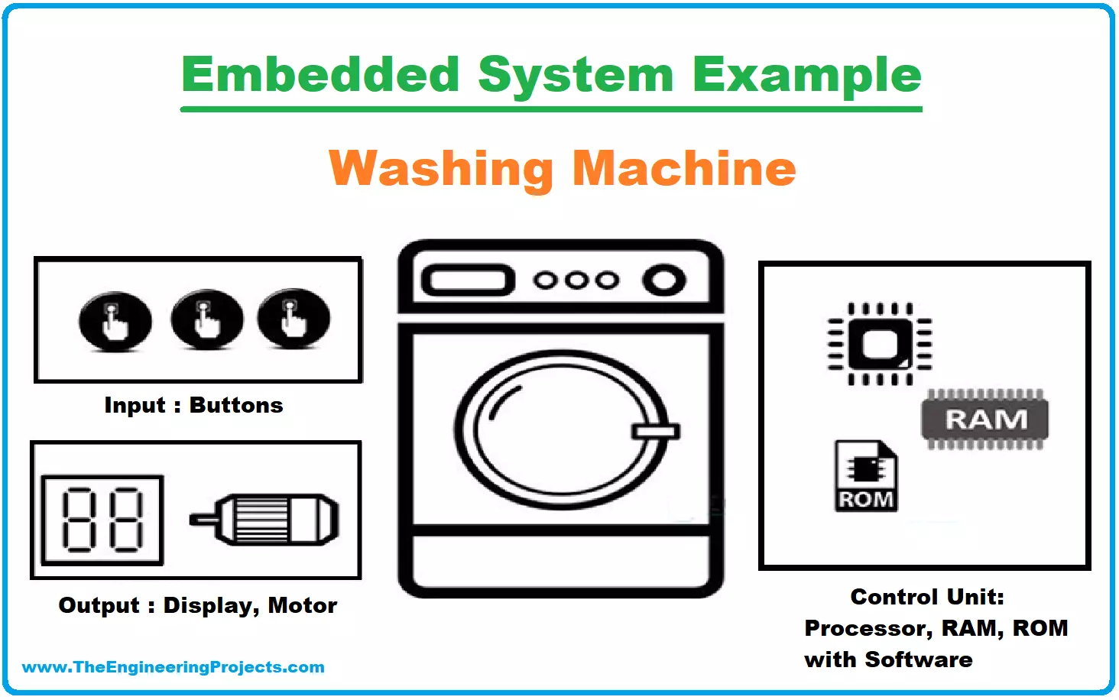
1. Specificity
Embedded systems can either be domain-specific or task-specific.
An embedded system is designated to perform the dedicated task only, it cannot be made to perform several automated functions from different inputs.
Examples: A digital blood pressure monitor
real-world, real-time, and highly specific embedded system. It performs only one focused task: accurately measuring and displaying a patient's blood pressure and heart rate.

Slide 4
2. Strict Design Parameters
The design metrics are pre-defined for every system but they are configurable to a great extent, or we can say there is room for additions and extensions in systems other than embedded systems.
But there is very little room for extensions and additions in an embedded because we have to fix everything on a single chip
strict design parameters refer to well-defined, non-negotiable constraints that the system must meet to function reliably, efficiently, and safely in its intended environment.

Slide 5
Cont…
A pacemaker is a medical embedded system with extremely strict design parameters:
Parameter | Required Design Constraint
Power | Must operate for 5–10 years on a coin-cell battery.
Size | Must fit inside the human chest.
Timing | Must trigger electrical pulses at exact intervals to regulate heartbeat.
Reliability | Must not fail—life-critical system with near 100% uptime.
EMI Immunity | Must not be disrupted by mobile phones, MRI machines, etc.
Security | Wireless telemetry must be encrypted to prevent hacking.
Compliance | Must meet FDA, ISO 13485, and IEC 60601 medical device standards.

Slide 6
3. Efficiency
An embedded system must be efficient enough to react and respond to the real-time environment.
In certain real-time embedded systems, a system has to react according to the real-time situation and adjust accordingly such as the air conditioner works on the same principle.
The cruise control of a car also works in a real-time response manner by reacting to the real-time situation hence managing the speed and brakes.
Efficiency in embedded systems refers to how effectively a system uses its hardware, software, and energy resources to perform its intended tasks with minimal waste—in terms of power, processing time, memory, and cost.

Slide 7
Cont…
Type | Description
Power Efficiency | Maximizing battery life or minimizing energy consumption.
Computational Efficiency | Getting more done with fewer CPU cycles or lower clock speed.
Memory Efficiency | Using RAM and flash storage economically.
Code Efficiency | Writing optimized code for speed and size.
Cost Efficiency | Delivering required performance with minimal hardware cost.

Slide 8
Cont…
Application | Why Efficiency Is Critical
IoT Devices | Longer battery life, lower bandwidth.
Medical Implants | Life-critical uptime on tiny power sources.
Automotive ECUs | Must work under tight power budgets.
Wearables | Small form factor = limited battery & CPU.
Satellite Systems | Limited energy, no room for error or waste.

Slide 9
4. Exclusive Memory
Embedded systems don't have a secondary memory, their memory is present in embedded software in the form of ROM.
Embedded systems can't have their memories extended or configured, have you thought why? Let me tell you because they are not general-purpose computers we use normally! They are dedicated systems for special tasks!

Slide 10
Cont…
Memory Type | Description
SRAM | Fast, volatile memory often divided into exclusive blocks for RTOS tasks or peripherals.
Flash/ROM | Non-volatile memory with sections exclusive to bootloaders or firmware.
TCM (Tightly Coupled Memory) | Fast, deterministic memory in some MCUs for exclusive real-time code.
EEPROM | Sometimes partitioned for exclusive access to configuration storage.
Peripheral-Specific Memory | Buffers reserved only for communication interfaces (e.g., USB FIFO, CAN, UART).

Slide 11
5. Multi-Rate Operational System
Some of the large-scale embedded systems are multi-rate operational systems i.e a large number of embedded systems are performing their dedicated functions independently to run a system.
All the multi-rate operational, embedded systems are well articulated to work synchronously with each other.
A car is such an example, many embedded systems work independently to keep a car on road.
A Multi-Rate Operational System in an embedded system refers to a system where different tasks or components operate at different execution rates or frequencies.
This approach is common in real-time embedded systems, particularly in applications like automotive control systems, robotics, aerospace, and industrial automation.​

Slide 12
6. Compact Design
An embedded system is designed to compact and lightweight as everything is to be placed on a single chip to perform a task including the microcontroller, timer, I/O parts, and the embedded software as well.

Slide 13
7. Minimal Power Dissipation
Embedded systems are designed in such a way to dissipate power at its minimal.
The goal is to conserve power and prevent overheating of the system by adding in heat sinks and cooling fans, and sometimes a larger battery is used to run the system.
Especially important for battery-powered or portable devices.
Emphasis on power-efficient components and software.

Slide 14
8. Sophisticated Functionality
Embedded systems are highly advanced and developed these days, which are not aware of the sophisticated functionalities of mobile phones and tablets.
They are designed to perfection keeping in view the needs and demands of the consumer market!
Every other person wants to own an Apple iPhone, isn't it? Just because of their sophisticated functionality!
Sophisticated Functionality in Embedded Systems refers to the integration of advanced features that go beyond basic control and signal processing.
These capabilities enhance performance, adaptability, intelligence, and user interaction, enabling embedded systems to meet complex application demands in fields like automotive, medical, industrial, aerospace, and consumer electronics.

Slide 15
Technologies Enabling Sophisticated Embedded Systems
Microcontrollers (MCUs) with DSP, floating point, or neural processing units (e.g., ARM Cortex-M7, Cortex-A).
FPGAs for hardware-level parallel processing.
(An FPGA (Field-Programmable Gate Array) is an integrated circuit that can be custom-programmed and re-programmed after manufacturing to perform specific digital tasks. Unlike standard processors, an FPGA's hardware architecture is defined by the user via software, offering massive parallel processing, low latency, and high-speed signal processing.)
SoCs (System on Chip) integrating CPUs, GPUs, and accelerators.
RTOS or Linux-based platforms for high complexity and flexibility.

Slide 16
9. Minimal User Interface
Have a brief look at your air conditioner, your oven, or your washing machine, you might have noticed one thing in common, a minimal user interface.
Embedded systems are designed with minimal user interface because users have almost nothing to do by themselves, you only have to provide the input or we can say instructions, the system is already fully automated to perform the designated task accordingly!
A fully automatic washing machine works on its own after the programme is set and stops once the task is over
A Minimal User Interface in an embedded system refers to a simple, low-resource, and often non-graphical way of interacting with the system.
This is common in systems where size, cost, power consumption, or simplicity is prioritized over rich interactivity.

Slide 17
Cont…
Real time use case:
Environmental Monitoring Systems: Weather stations, air quality monitors, soil sensors
Access Control Systems: Keypad door locks, RFID readers, security panels
IoT Edge Devices: Smart plugs, motion detectors, asset trackers

Slide 18
10. Safety Factor
A safety analysis is always necessarily carried out for the embedded systems to ensure the safety of the operator and the environment in case of any material damage or hazardous emissions from the system.
Embedded systems often control real-world physical processes.
Failures can lead to equipment damage, data loss, or even injury/death.
They are often part of certified safety-critical systems (e.g., ISO 26262 for automotive, IEC 61508 for industrial).

Slide 19
Cont…
Common Safety Standards for Embedded Systems
Industry | Standard | Description
Automotive | ISO 26262 | Functional safety of road vehicles.
Industrial | IEC 61508 | Safety of electrical/electronic systems.
Medical Devices | IEC 62304 | Software lifecycle processes.
Railways | EN 50128 | Railway applications software safety.
Aerospace | DO-178C | Software safety in airborne systems.

Slide 20
Cont…
Real-Time Use Case: Airbag Deployment System in Automotive Embedded Systems
An Airbag Control Unit (ACU) is a real-time, safety-critical embedded system that detects vehicle collisions and triggers airbag deployment within milliseconds to protect passengers. It must operate flawlessly under strict timing and safety constraints, making it a classic real-world use case for safety factor in embedded systems.
Inputs:
Accelerometers and gyroscopes (IMU sensors)
Crash sensors (impact sensors)
Seat occupancy sensors
Outputs:
Airbag inflator trigger
Seatbelt tensioner activation
Data logging to black box (event data recorder)
Task | Time Constraint
Collision Detection | Within 2–3 ms
Decision to Deploy Airbag | Within 5–10 ms
Trigger Inflator Signal | Less than 20 ms total from impact
Real-Time Requirements
An inflator is a device that increases the volume of something, typically by pumping air into it

Slide 21
11. Cost-Effective
An embedded system is designed in such a way to make it cost-effective, overall the circuit is small since everything is present on a single chip.
A compact design and designated functionality make an embedded system less costly and high speed.
Principle | Description
Minimal Hardware | Use low-end microcontrollers (e.g., 8-bit or 32-bit MCUs) with built-in peripherals.
No Operating System or Lightweight RTOS | Avoid licensing costs of commercial OS; use FreeRTOS or run bare-metal.
Efficient Design | Use only essential sensors/components; avoid overengineering.
Open-Source Tools | Use GCC, PlatformIO, Arduino IDE, KiCad, etc., to reduce development cost.
Low Power Consumption | Enables cheaper power supplies and longer battery life.
Mass Production Ready | Uses widely available, inexpensive parts (e.g., STM32, ATmega328P, ESP32).

Slide 22
Cont…
A cost-effective embedded system focuses on affordability without compromising essential performance. It’s especially useful in:
  IoT devices
  Consumer electronics
  Wearables
  Remote monitoring systems

Slide 23
Summary
Requires real time performance
It should have high availability and reliability.
Developed around a real-time operating system
Usually, have easy and a riskless operation, ROM boot
Designed for one specific task
It must be connected with peripherals to connect input and output devices.
Needed minimal user interface
Limited memory, low cost, fewer power consumptions
It does not need any secondary memory in computer.

